Slide 1
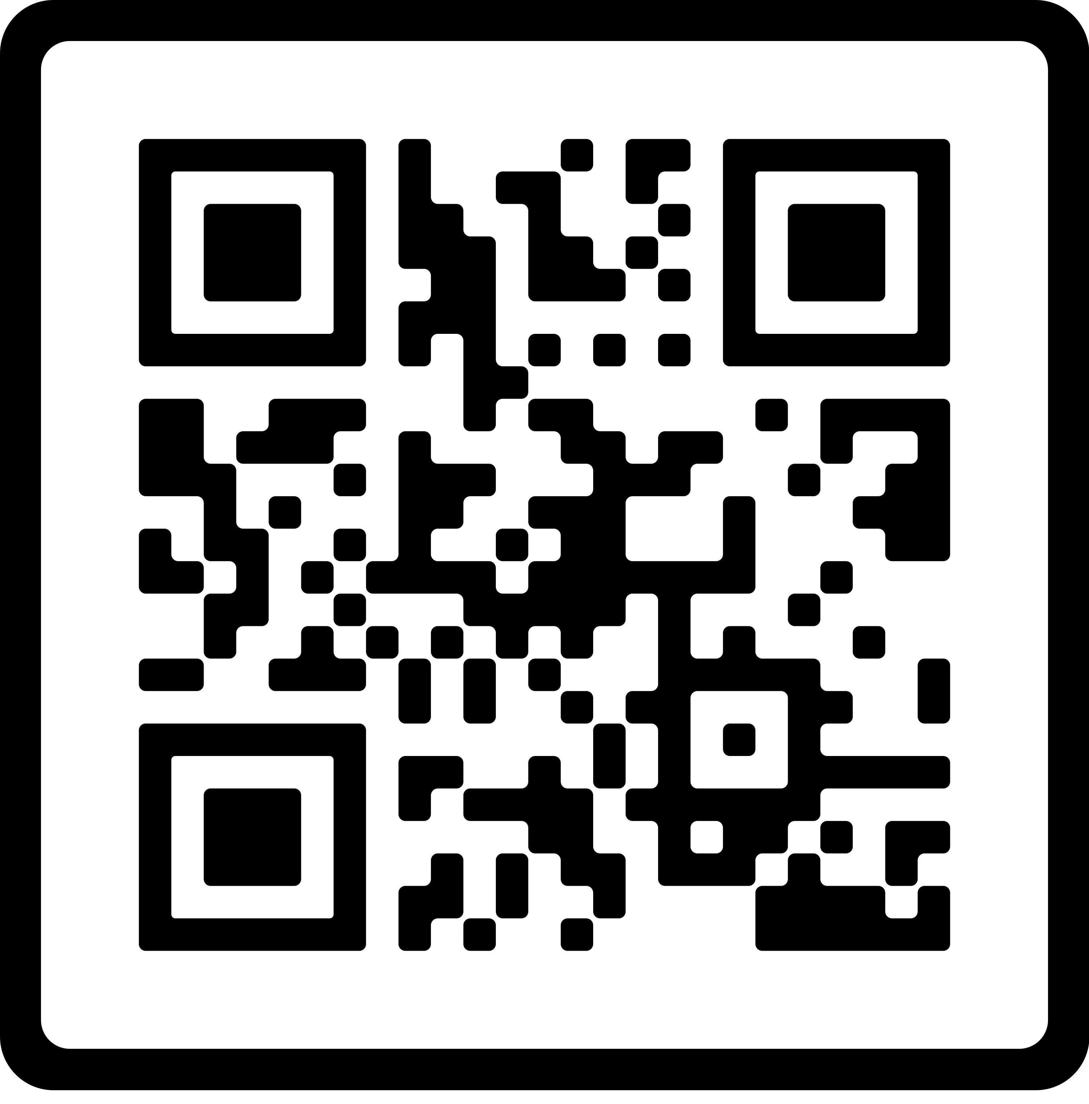
Topic: Mental Health Awareness
Your mental health is everything – prioritize it. Make the time like your life depends on it, because it does." — Mel Robbins
May is Mental Health Awareness month. Take a moment to explore how you can take steps to prioritize your mental health and understand how it affects you and others around you.
Resources:
Mental Health Awareness Month | SAMHSA
Seize the Awkward | Talk With A Friend About Mental Health
Films Mental Healthy F.i.T. (mentalhealthyfit.org)
Faith Community Health at Carle connects you and your faith community to needed healthcare and wellness support, taking a whole-person approach to health.
To learn more about bringing healthcare and wellness resources to your faith community, call (217) 902-3160 or email FaithCommunityHealth@carle.com.

