Slide 1
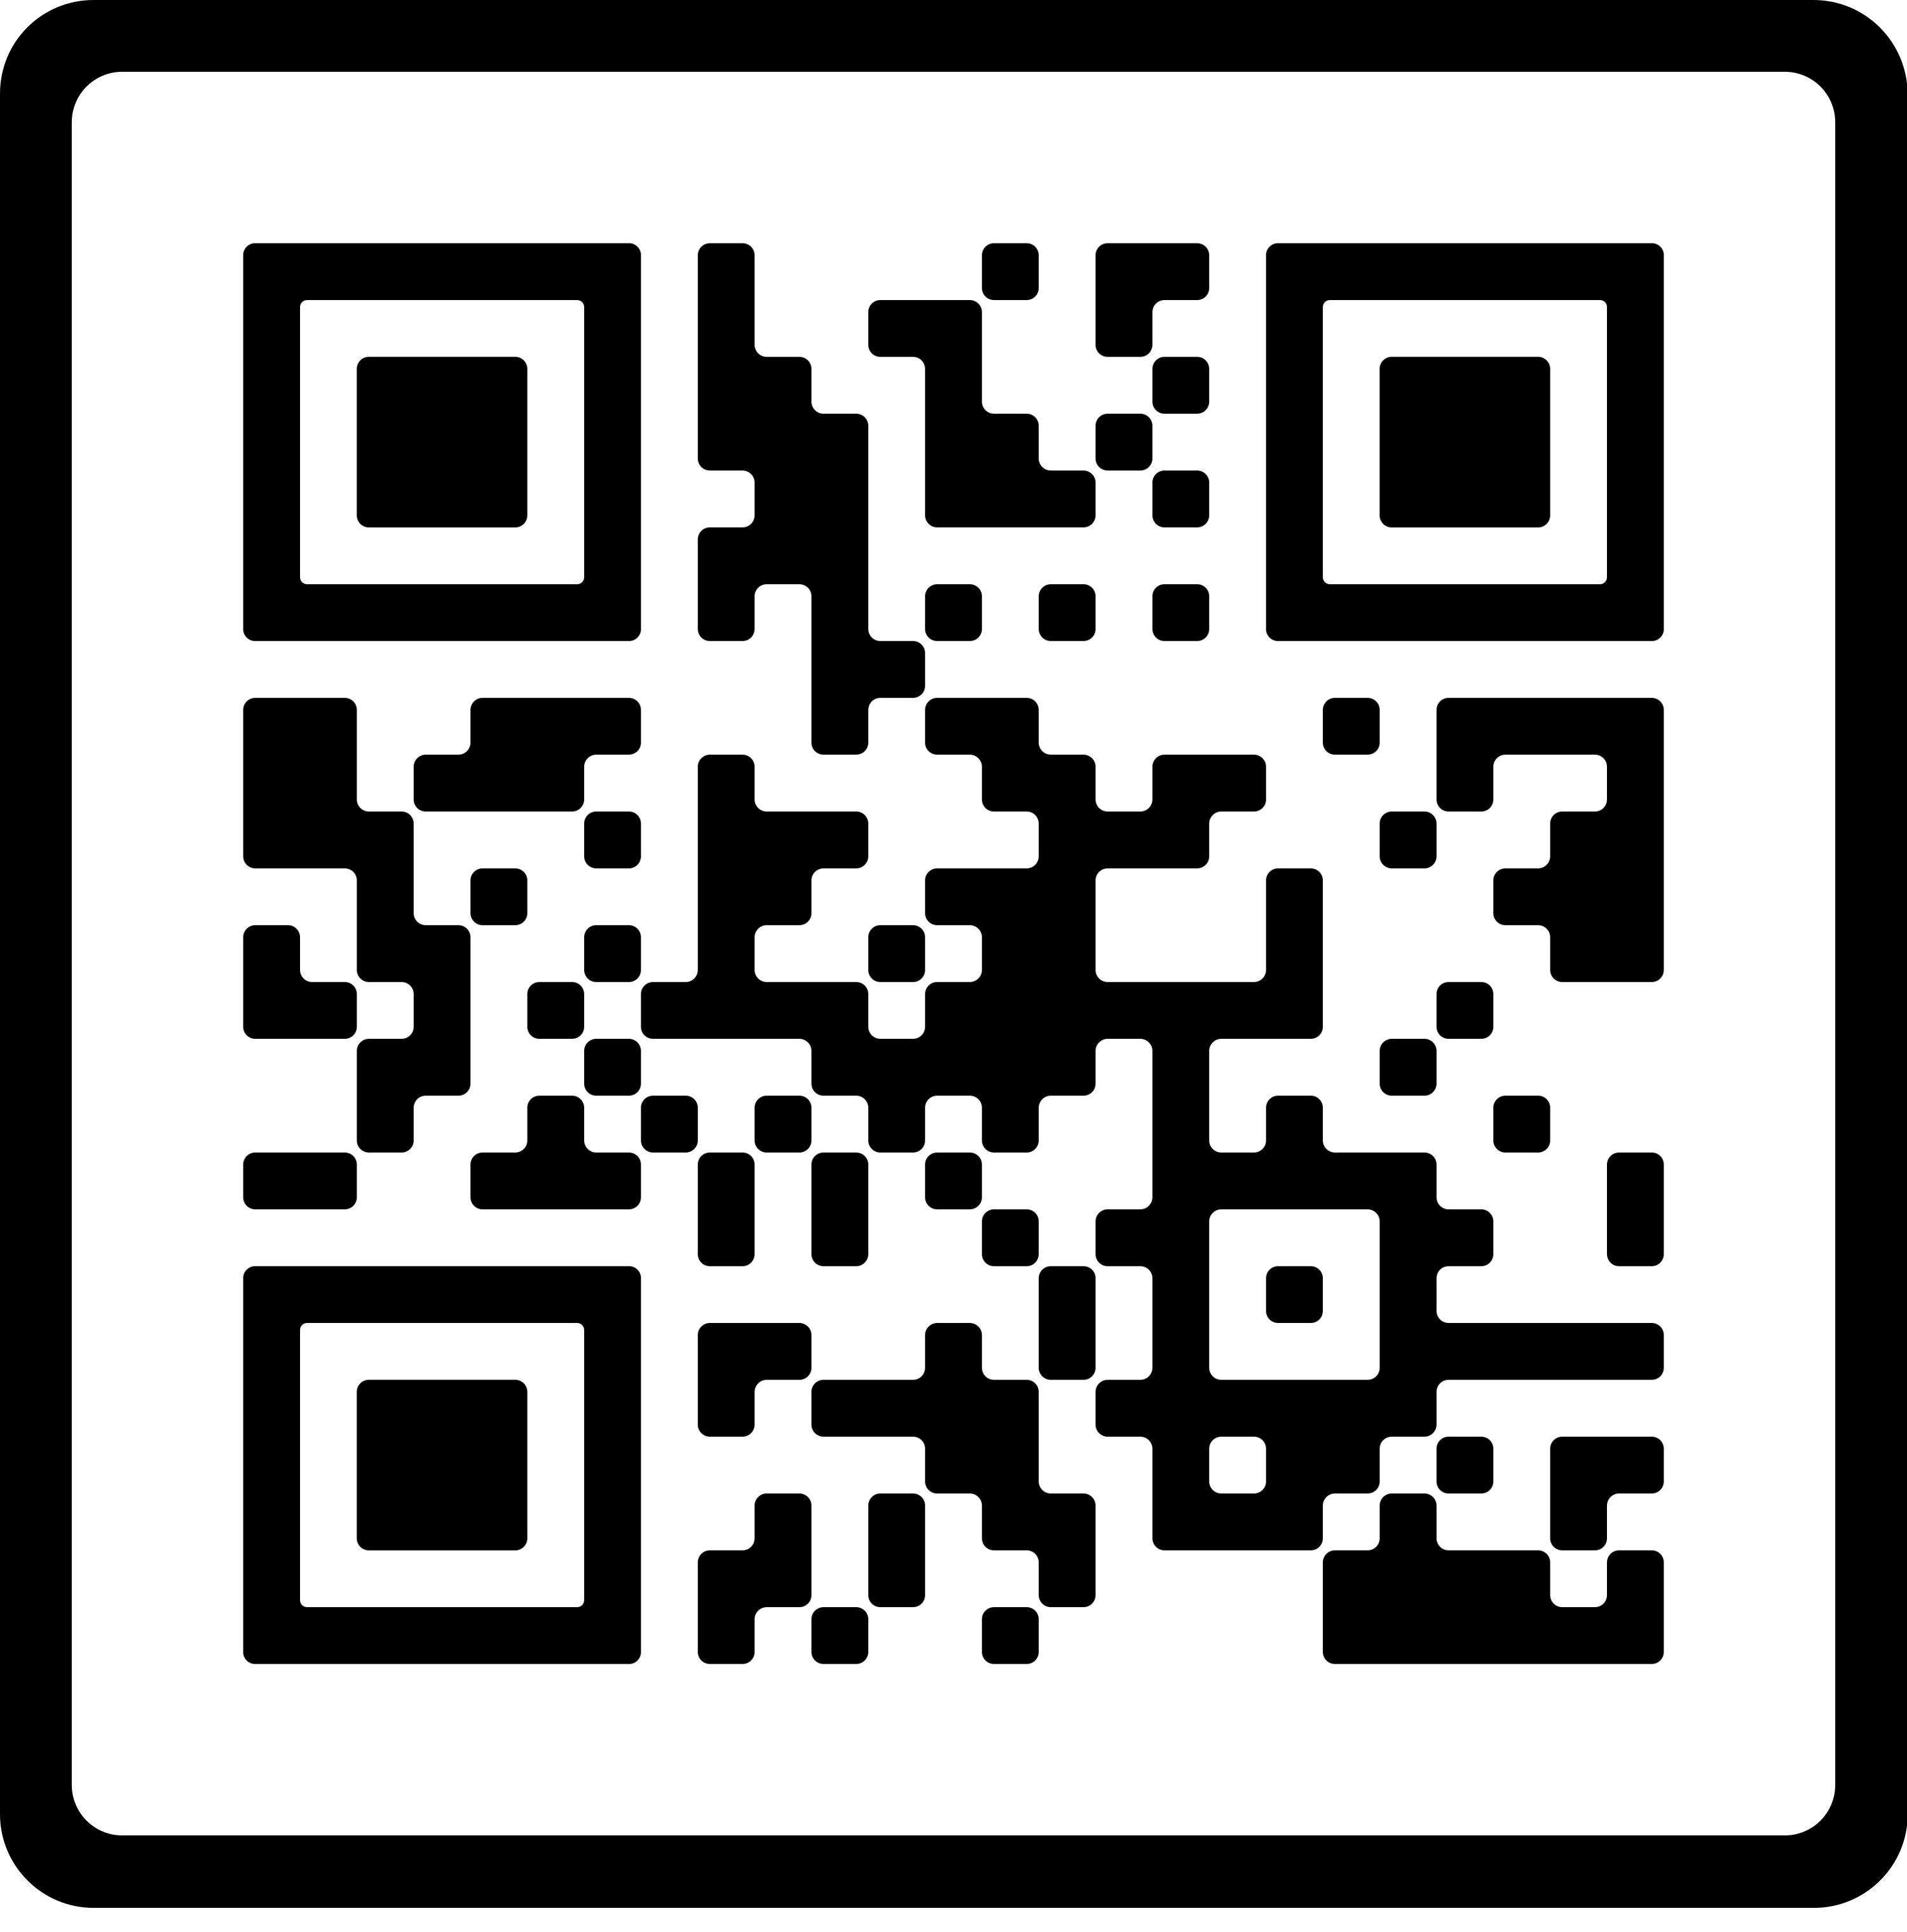
Topic: Sun Safety
The Heat Is On! Stay Safe!
Typical Illinois weather can include all four seasons within one week. Pools will soon be opening up and ready for the summer season but are you? Even in the cooler days, have you packed your sun screen, sun hat and safety glasses? UV rays are present whether it is 30 or 90 degrees.
Resources:
www.nfcr.org
www.epa.gov/sunsafety
Faith Community Health at Carle connects you and your faith community to needed healthcare and wellness support, taking a whole-person approach to health.
To learn more about bringing healthcare and wellness resources to your faith community, call (217) 902-3160 or email FaithCommunityHealth@carle.com.

